Slide 1


Innovation for productivity growth in Brazil
Ideas from the UK
IPEA, World Bank, OECD, Brasilia, July 2015
Kirsten.bound@nesta.org.uk

Slide 2



http://www.demos.co.uk/files/Brazil_NKE_web.pdf?1240939425; http://www.cgee.org.br/publicacoes/atlas_of_ideia.php

Slide 3
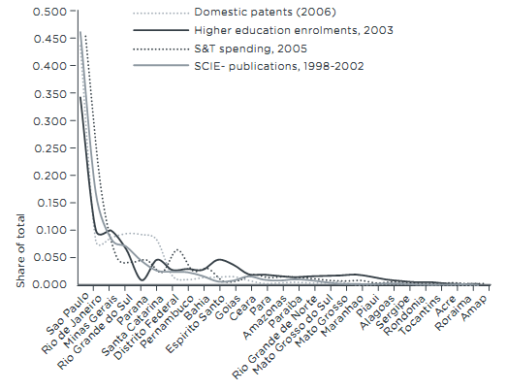
http://www.demos.co.uk/files/Brazil_NKE_web.pdf?1240939425

Slide 4










Research & Analysis - understanding how innovation happens and how to support it
Innovation Lab - supporting innovation in governments, local authorities and civil society
Innovation Skills – supporting abilities to innovate via tools, training, networks
Investments - in early stage companies, social enterprises and venture intermediaries
Notes:
Format this if time

Slide 5
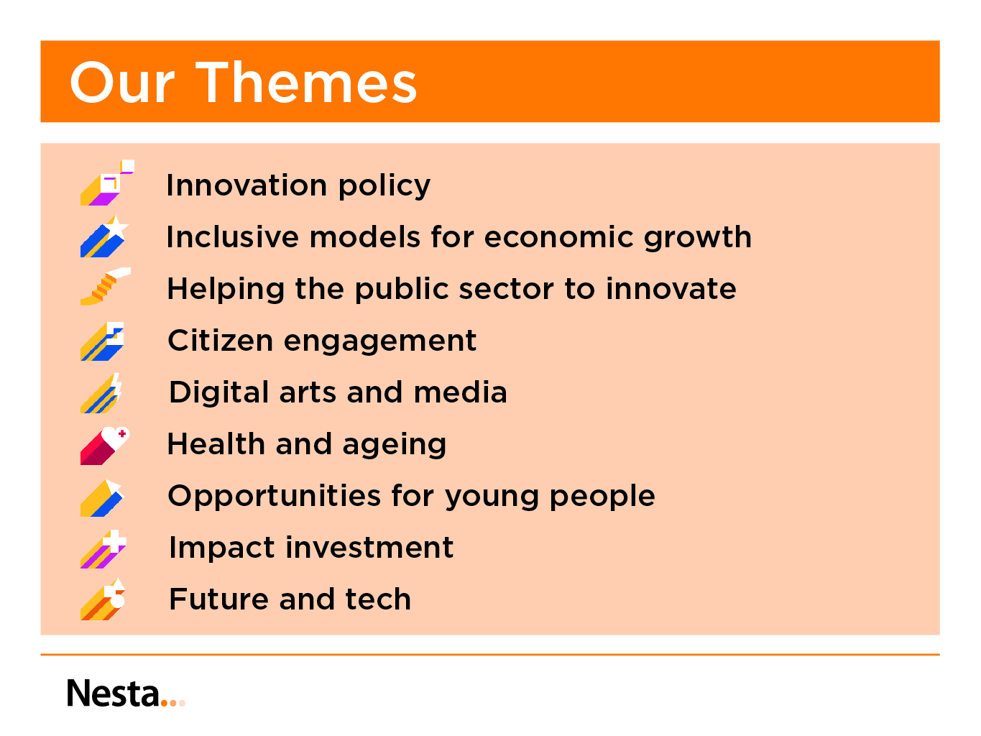

Slide 6


Evidence
Are innovation policy deficiencies mainly due to problems with design or problems with implementation?
How to get better at absorbing technology and ideas from elsewhere?
How to foster a greater mission-oriented focus for innovation support efforts?
Experimentation
Data
Judgement
?
Putting the
public back into public policies
for innovation

Slide 7
Are innovation policy deficiencies mainly due to problems with design or problems with implementation?
Evidence
Experimentation
Data
Judgement

Slide 8

The Innovation Policy Evidence Compendium:
20 reports, over 1400 international evaluations
Increasing inputs to innovation | R&D tax credits, grants for R&D, public support for venture capital and loan guarantees
Increasing non-financial capabilities (eg access to skills and expertise) | Support for exploiting IP, technical support services, skilled migration and mobility schemes
Enhancing connections and complementarities | Cluster policy, support for networks, collaborative R&D programmes, support for intermediaries
Enhancing demand for innovation | Public procurement policies, pre-commercial procurement of R&D, inducement prizes
Framework conditions for innovation | Regulation, standards, entrepreneurship policy
Improving discourse and preparedness | Foresight and horizon scanning
http://www.innovation-policy.org.uk/

Slide 9
There is a great deal of uncertainty about what works and why when it comes to innovation policy
 | Policy Instruments | Overall Quality of evidence | Evidence for: | Mixed evidence for: | No evidence for:
Supply | Fiscal incentives for R&D | *** | incremental or process innovation | radical innovation | productivity gains
 | Direct support to R&D and innovation in firms | *** | Increased investment, esp. in low tech, weaker regions, smaller companies | innovation output, economic performance and sustained behavioural change
 | Access to finance: publicly supported venture capital | ** |  |  | for stimulating innovation
 | Access to finance: loan guarantees | ** | business growth, sales and employment | adverse selection (supporting weaker firms, to the detriment of innovators) | firm productivity, R&D or investment intensity
 | Policies for training and skills | * | increased training, better infrastructure of skills | innovation performance and expenditure, in-house rather than outsourced skills | Effects on innovation rather than general performance
 | Innovation and human resources: employment protection | * | enterprise investments in skills; incremental innovation | dismissal protection promotes economic growth in innovation intensive sectors, encourages investment in human capital | effects of labour regulation on innovation
 | Innovation and human resources: immigration of high-skilled workers | ** | innovative capacity, contribution to new tech firms, academic articles and collaborative sci/tech work |  | innovation performance of migration policies/labour legislation
 | Support measures for exploiting intellectual property | ** | increase in University patenting from policy-induced system changes | innovation impact | promotion of private-sector patenting
 | Entrepreneurship policy | ** | Business growth, |  | Programmes combining entrepreneurship and locational intervention
 | Technical services and advice | * | Improved environmental performance, productivity, product development and innovation | Significant/fundamental improvements for participants
 | Cluster policy | ** | building connections | building clusters from scratch, cluster participation on firm performance
 | Policies to support collaboration for R&D and innovation | *** | Input additionality, collaboration, building connections, increased employment and value added, increased patenting | Output effects (learning, attitudes, creativity, internationalisation)
 | Innovation network policies | * | building connections | Effects on learning and skill enhancement | which networks contribute to innovation (if any) or how; policy-driven development (over organic development)
Demand | Measures to stimulate private demand for innovation | * |  | price-based mechanisms for incremental; command-and-control for radical | stimulation of further innovation
 | Public procurement policies | * | tackling deficiencies of practices in relation to innovation; positive effects on target group, public bodies and their capabilities |  | efficacy of policies to achieve aim; behavioural additionality; subsequent additionality; repercussions of diffusion on subsequent innovation activity
 | Pre-commercial procurement | ** | short-run effects on innovation and economy; contributing to firm growth and innovation | diffusion of innovation, long-run effects | PCP schemes being more or less effective than other methods
 | Innovation inducement prizes | * | Positive prestige effects for sponsors, increasing innovation; increased awareness | Opportunity for experimentation in innovation policy | Long term effects of prizes in this field
 | Standardisation and standards | ** | growth effects, increase in patenting
 | Regulation | ** | negative effects from policy uncertainty; positive effects for larger companies who can comply | Innovation effects, particularly in the long run; negative effects on companies with less capacity for compliance
 | Technology Foresight | * | innovation policy design | improved depth of reflection on policy; provides platform for instrumental informed debate | high order impacts of foresighting
R&D tax credits increase incremental innovation; no evidence they increase firm productivity; impact on radical innovation is unclear
Cluster policies do help build connections between firms, but evidence that they improve firm performance is mixed
Source: Nesta/University of Manchester review of evaluations in 18 policy areas
Notes:
20 reports, reviewing a total of 1402 documents.

Slide 10
Are innovation policy deficiencies mainly due to problems with design or problems with implementation?
Evidence
Experimentation
Data
Judgement

Slide 11
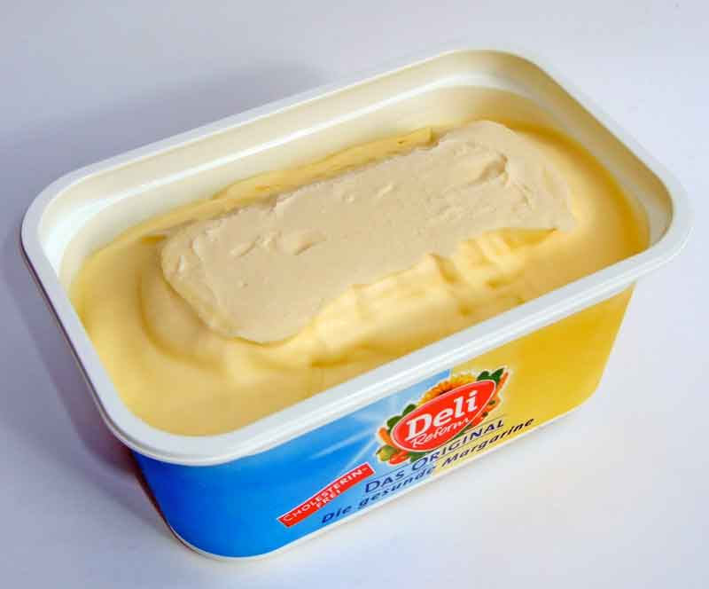

Data sources for innovation policy are far behind where we need them to be – the example of video games in the UK
SIC 10.42: Manufacture of margarine and similar edible fats
SIC 90.03 Artistic creation
SIC 62.02 Computer consultancy
SIC 82.99 Other business support activities
SIC 62.09 Other information technology and computer service activities
SIC 58.21 Publishing of computer games
SIC 58.29 Other software publishing
SIC 62.01/1 Ready-made interactive leisure and entertainment software development
SIC 32.40/9 Manufacture of games and toys not elsewhere classified
Image: Wikimedia
Image: Rockstar
Notes:
when it comes to new and interesting bits of the economy, the official statistics aren’t much use.
If you’re interested in something like the manufacture of margarine, you’re in luck. All the companies that make it are registered in SIC 10.42.
But if you’re interested in something a little more cutting-edge, you’re in trouble. Some research by the University of Brighton FUSE project found games companies in eight different sectors. Until recently, Rockstar Games, makers of the world-dominating GTA franchise, were classed as miscellaneous toymakers. So looking at the data you would have been forgiven for thinking the UK had an amazing, world-class toymaker in our midst.

Slide 12
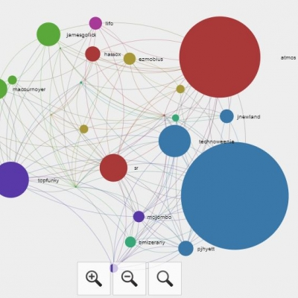

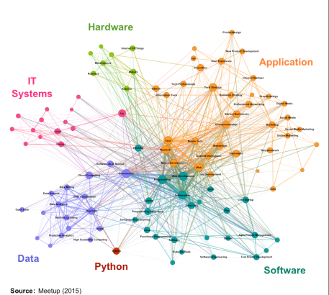
We need to exploit new sources of (big) data for innovation policy…
So far good prospects in:
Analysing clusters
Understanding the impact of events
Identifying emerging sectors
Looking at links and networks within industries
Understanding skills needs rapidly and cheaply
But avoid ‘info-porn’!
http://www.nesta.org.uk/blog/finding-technology-innovators-using-big-data-web; http://www.nesta.org.uk/blog/how-track-innovative-jobs-real-time; http://www.nesta.org.uk/blog/using-big-data-map-uk-video-games-industry; http://www.nesta.org.uk/blog/unconventional-data-and-worldly-wisdom-2-2-matrix;

Slide 13
Are innovation policy deficiencies mainly due to problems with design or problems with implementation?
Evidence
Experimentation
Data
Judgement

Slide 14
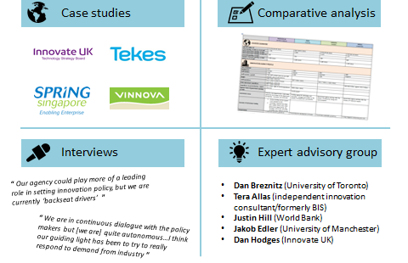
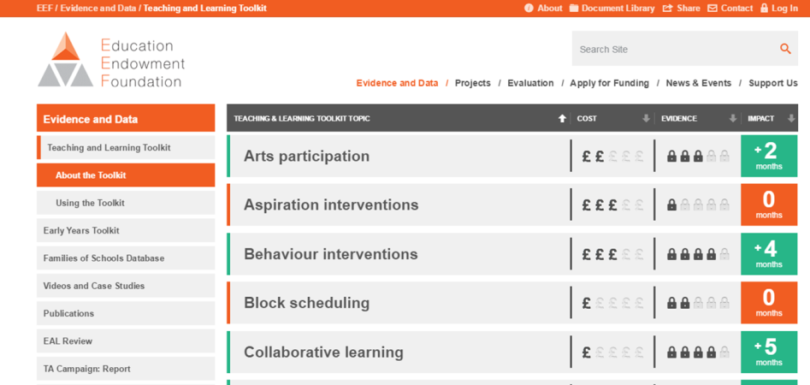

Developing the ability to understand and USE evidence at all levels is just as important as the ability to generate it…
The importance of effective implementation is frequently overlooked – we are far better at adopting policies in name than in practice
We need to pay much more attention to the USEFULNESS and USABILITY of evidence
New project on How (and how well) Innovation Agencies work: http://www.nesta.org.uk/blog/how-do-innovation-agencies-work; Alliance for Useful Evidence: http://www.alliance4usefulevidence.org/; Education Endowment Foundation toolkit: https://educationendowmentfoundation.org.uk/toolkit/

Slide 15
Are innovation policy deficiencies mainly due to problems with design or problems with implementation?
Evidence
Experimentation
Data
Judgement

Slide 16
What is an experiment? A continuum of definitions…
Trying something new
Trying something new and put in place the systems to learn
Test a hypothesis
Codifying and sharing resulting knowledge
RCTs
Randomised controlled trials
Different from a natural experiment
No rigorous learning or evaluation strategy
No real “testing mindset”
Sometimes but not always with some form of control group
Rigorous formal research design
Control group created by the programme manager/researcher using a lottery
A “pilot”
Field vs. “lab” experiments

Slide 17





1. Experiment
2. Evaluate
3. Scale-up
Control group

Slide 18
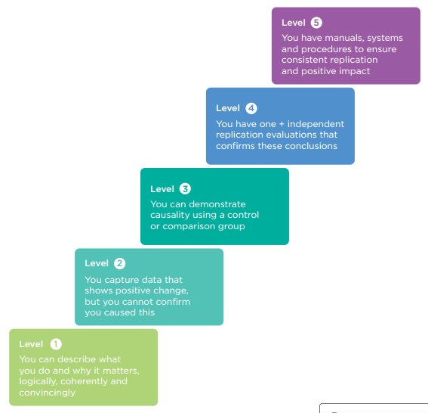
Many forms of experimentation are valuable, but so is the ability to make an effective case for impact:
We advocate the use of a universal set of
‘standards for evidence’…
http://www.nesta.org.uk/publications/nesta-standards-evidence

Slide 19
Why haven’t governments and researchers used more RCTs to understand innovation and its drivers, in contrast to other policy areas?
Governments
Researchers
Lack of sufficient examples showcasing their feasibility and value have made governments and intermediary organizations very reluctant to consider using RCTs in this area
Missing networks
Very few academic researchers in related fields have developed the capabilities and required support infrastructure necessary to set up and run experiments
The networks between researchers and practitioners are missing, so even when they would be interested in collaborating on an RCT, they typically don’t know how to find each other
Insufficient knowledge
There is insufficient knowledge about when is appropriate and feasible to use RCTs in this domain, and a widely-held misperception that RCTs need to be expensive

Slide 20




IGL is a new global collaboration led by Nesta that develops and tests different approaches to support innovation, entrepreneurship and growth
www.innovationgrowthlab.org
The new global laboratory for innovation and growth policy
Increase innovation
Support high-growth entrepreneurship
Accelerate business growth
Notes:
A new global laboratory for innovation and growth to tackle these 4 factors simultaneously

Slide 21










Our partners so far…
And on-going discussions with several other organisations

Slide 22
Activities
Running trials:
Funding trials:
Building and connecting communities:
Promoting wider adoption of trials:
Creating useful resources:
Disseminating lessons:
We work with our partners, other public and private organisations, and innovative companies to identify new opportunities for trials, which we then develop and run in collaboration with researchers in the IGL Research Network
We support randomised trials through the IGL Grants programme, a bottom-up approach to identify and fund promising trials worldwide, encouraging more researchers and organisations to get into this space
We bring together researchers working on randomised trials in this field through the IGL Research Network, and play a matching and brokerage role to help them connect with our growing network of partner organisations open to adopting randomisation in their programmes
We advocate the need to improve the evidence base on innovation and growth policy, and showcase the value of randomised trials in this space in order to encourage wider adoption
We aim to improve the knowledge base and develop best practice on how to do randomised trials in this space, learn when they work and when don’t, and hence when to use and not to use them, creating useful resources to reduce the challenges faced by organisations interested in using randomised trials
We act as an aggregator of the evidence emerging from randomised trials worldwide (see our forthcoming trials database), and translate it into actionable insights that are useful for both policy-makers and practitioners, disseminating them widely through a range of activities such as presentations, conferences, webinar series and publications

Slide 23
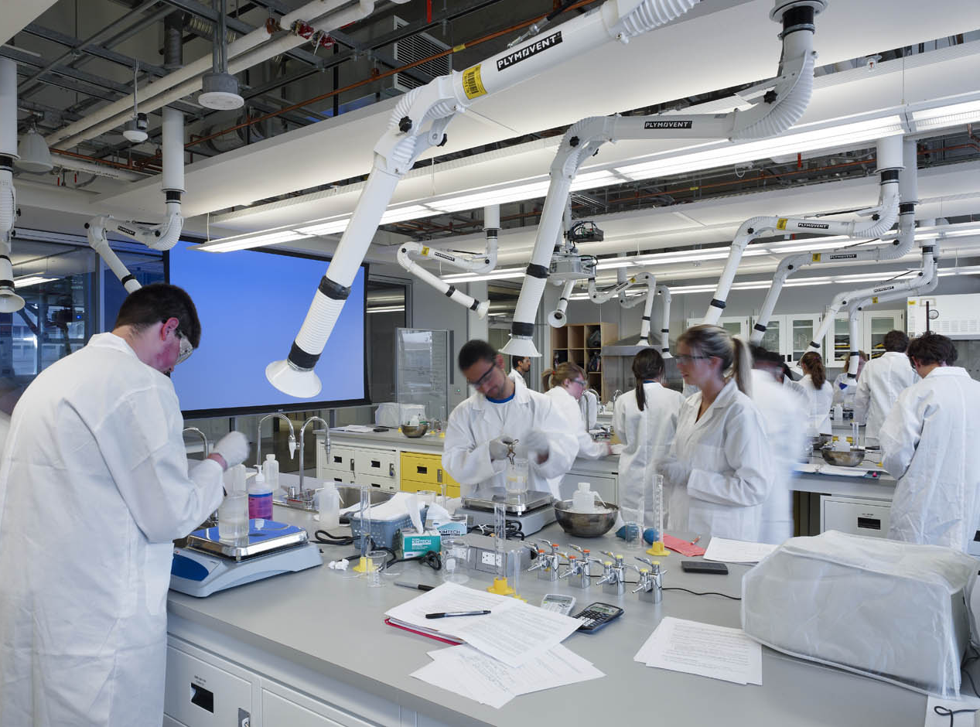
Making science labs collaborative innovative spaces
How do different types of proximity impact collaboration and knowledge generation, and thus how should research campuses be designed to maximize the probability of breakthrough innovations?
Participants: Academic researchers across different scientific fields (biomedical, space, nuclear, energy and IT science) who are soon to be reallocated for 6 months in a temporary building
Randomises the exact location of researchers within the building and collects data on collaborations (from publications to wifi hotspots)
In addition, randomly provides some researchers with opportunities for other types of co-location (virtual via software and stays abroad with international travel grants)
MIT and Stockholm School of Economics

Slide 24

Increasing business-science links and technology transfer
Participants: A regions’ top 300 academic researchers in chemistry and SMEs in agro-food and pharma sector
Two treatment groups and one control group:
Academics get promoted through online platform that showcases their business-relevant academic research
Academics get offline promotion, including meetings/presentations to business R&D managers
No active or passive promotion provided
What is the impact of different types of knowledge transfer activities on the number and quality of business-science interactions?
City University/UPF and UAB

Slide 25

Incentivising employees to contribute new ideas
Participants: 777 employees in the Dutch branch of a large multinational
‘Innovation contest’ where employees submit ideas for new products/processes and receive corporate funding to further develop these
Phase 1: 2x2 design; opt-in/opt-out groups + flyers with peer effects/simple flyer
Phase 2: for those who don’t opt-in
Standard deadline extension
Deadline extension + social norm (% colleagues partaking in innovation contest)
Deadline extension + social norm (% top/mid. managers indicating employees should join)
Can subtle non-monetary nudges be used to influence intrapreneurial behaviour in a large corporation?
Radboud University Nijmegen and Utrecht University

Slide 26
How to get better at absorbing technology and ideas from elsewhere?
Can we learn from
?

Slide 27

http://www.nesta.org.uk/sites/default/files/chinas_absorptive_state_0.pdf

Slide 28

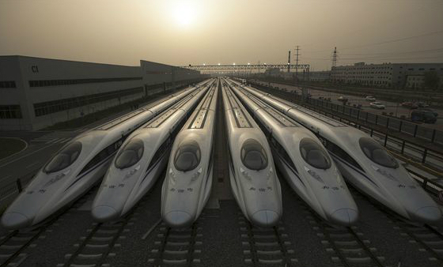


Narrative 1: China is a science and innovation superpower

Slide 29

Narrative 2: China is a fast follower
“Chinese technology companies shine by developing quickly enough to remain at the cusp of the global technology frontier, without actually advancing the frontier itself”

Slide 30

Narrative 3: China is a giant with an Achilles’ heel

Slide 31



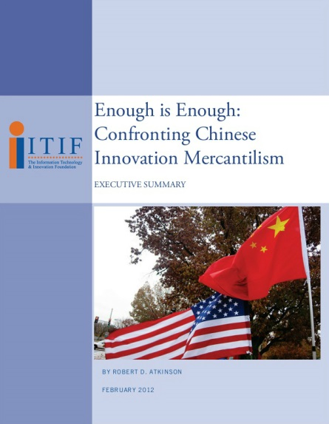
Narrative 4: China is a techno–nationalist
“China wants to compress a 40–year learning process into 10 years…by free riding on foreign technologies. Examples include forced technology transfer and IP theft.”
Rob Atkinson, CEO of ITIF and co–chair of the US–China academic innovation dialogue

Slide 32

China is an absorptive state, increasingly adept at attracting and profiting from global knowledge and networks
Notes:
http://bilder.bild.de/fotos/imago59843066-jpg_33047751_mbqf-1371482213-30879620/Bild/2.bild.jpg
Most of these narratives are too simplistic.
We argue that the defining feature of China’s innovation system is absorption – the ability to attract and profit from global knowledge and networks and recast and recombine these resources with an ever-improving domestic environment for innovation.
The supercomputer is a great example of how absorption works in practice….

Slide 33
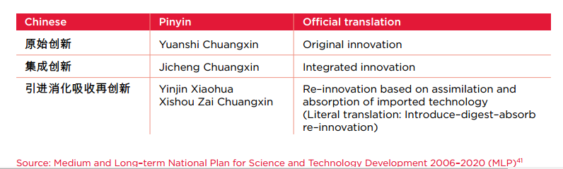
Absorption is a central feature of Chinese innovation policy
Concepts of indigenous innovation in Chinese policy:
Policy and targets
Dropping metrics that sought to diminish dependence on foreign technology and instead: and “bring in senior talent and advanced technology from overseas and encourage foreign enterprises to set up R&D centres in China in order for China to learn advanced international management concepts and systems.”
Notes:
There is a considerable literature on the tensions between foreign direct investment (FDI) and indigenous innovation in China. On the one hand, the MLP says that China should: “Assimilate and absorb a series of advanced technologies, master a number of critical technologies concerning the nation’s strategic interests, and develop a range of major equipment and key products that possess proprietary intellectual property rights.”45 It also says that China should reduce its dependence on foreign technology to 30 per cent by 2020.46 The 12th Five Year Plan (FYP), launched in 2011, dropped this metric,47 instead stating that China “will actively expand imports of foreign technology”48 and “bring in senior talent and advanced technology from overseas and encourage foreign enterprises to set up R&D centres in China in order for China to learn advanced international management concepts and systems.”49 This perhaps reflects a growing recognition by Chinese policymakers of quite how dependent the drive for indigenous innovation is on inflows of foreign technologies and ideas. Table 2 identifies progress against targets in the MLP.

Slide 34
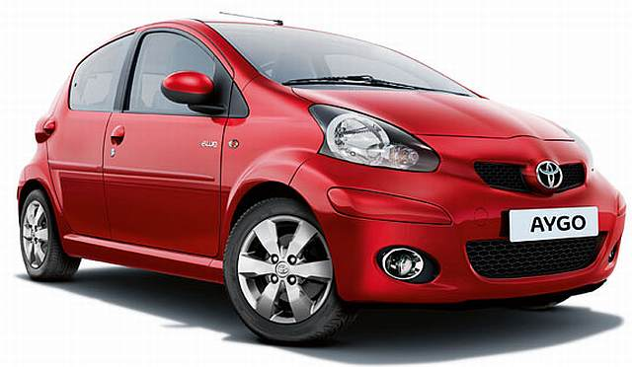
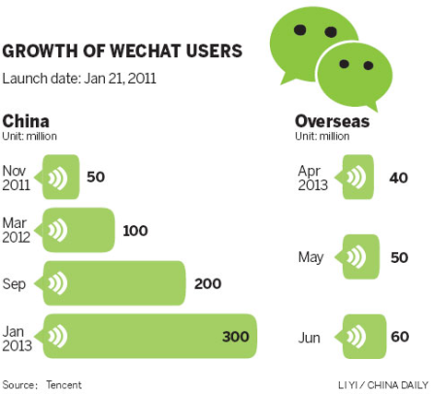



And rapid ‘re-innovation’ is a key competency of firms and production networks
After ‘Shanzhai’…
More than copying -finding new ways to add value:
Toyota Aygo
“China is a great place to be empirical and learn by doing. There is a boiling cauldron of people just trying stuff.”
Steve Cook, Strategy Advisor at BP
BYD F0
Notes:
you will often hear in the western media that Chinese businesses can’t innovate and can only copy foreign technologies and ideas. But one of the most interesting things we found during the research for this report is that Chinese companies have developed a distinct specialism in rapidly absorbing, adapting and market testing new products and technologies…

Slide 35
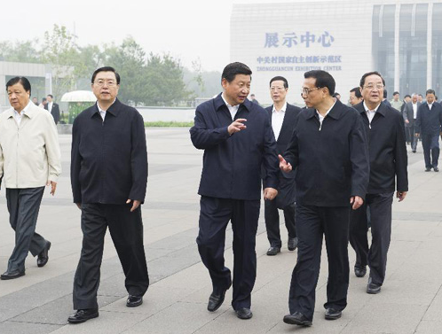
Combined with an increasingly ‘laser-like focus’ on international collaborations, could it remain a future source of competitive advantage?
“As the global competition …is heating up, we should unswervingly go down the path of innovation with Chinese characteristics”
President Xi Jinping, 5 March 2013

Slide 36
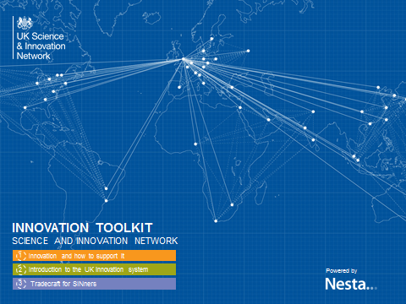





Absorption is also critical for advanced economies – but early days for policies supporting international innovation collaborations
But very early in understanding the most effective approaches to supporting international innovation collaborations
UK already a petri-dish for global research and innovation…
Around 45% of the UK’s scientific publications have an international co-author, and this share is growing rapidly.
An exceptionally high proportion of UK business R&D is funded from abroad
UK innovative firms are far more likely to be active in foreign markets than their counterparts in France, Italy
or Sweden
Notes:
In 2011, the UK attracted almost $7 billion of overseas-financed R&D – the same as Canada, Finland, Japan, China, and Russia combined.

Slide 37
How to foster a greater mission-oriented focus for innovation support efforts?
Putting the
public back into public policies
for innovation
Notes:
Big focus for Nesta is supporting innovation for public good, and inclusive innovation

Slide 38
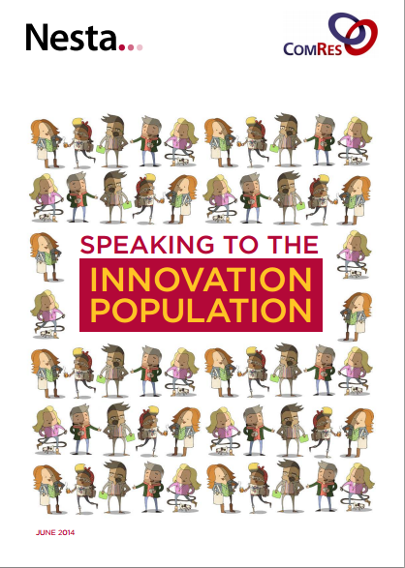

The best way to gain public support for investment in innovation is to focus on the potential outcomes: the difference it will make to people’s health, energy, education and agriculture…
http://www.nesta.org.uk/publications/speaking-innovation-population

Slide 39
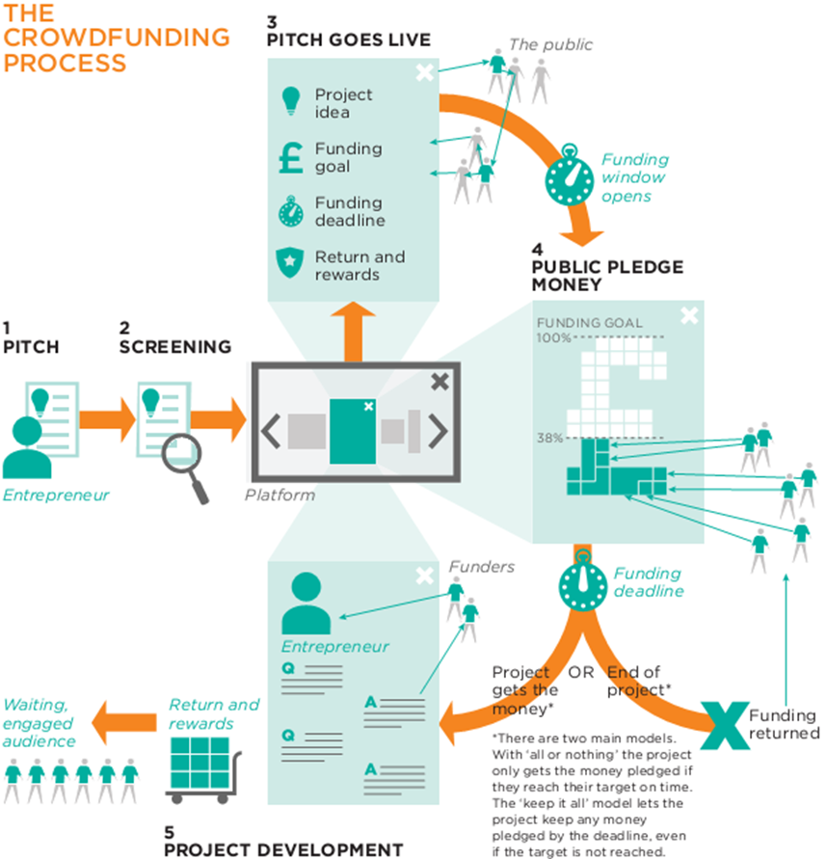


New technology platforms are enabling a new generation of inclusive innovation policies:
From crowdfunding..
To MOOCs
Or makerspaces
https://www.nesta.org.uk/sites/default/files/innovations_in_inclusive_innovation.pdf
http://www.nesta.org.uk/project/crowdfunding

Slide 40


In search of a next generation of innovation policies – we revived one from 300 years ago!
An inducement prize to solve one of the greatest challenges of our time…
Open to all
Reward achievement, not effort
Crowd in investment
Raise awareness of critical challenge
By the public, for the public
https://www.nesta.org.uk/sites/default/files/innovations_in_inclusive_innovation.pdf

Slide 41
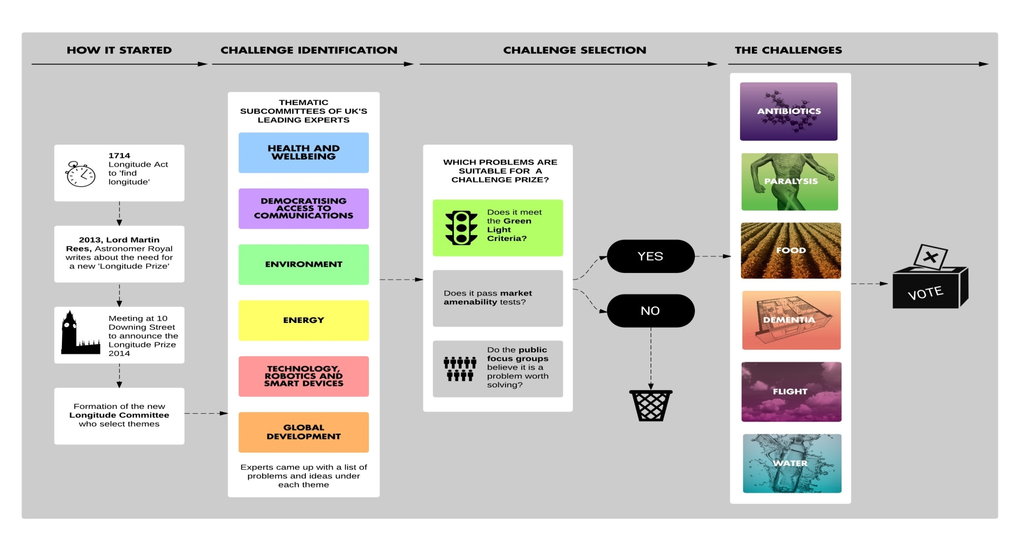
LONGITUDE PRIZE: Challenge Selection Process
150,000 public votes

Slide 42
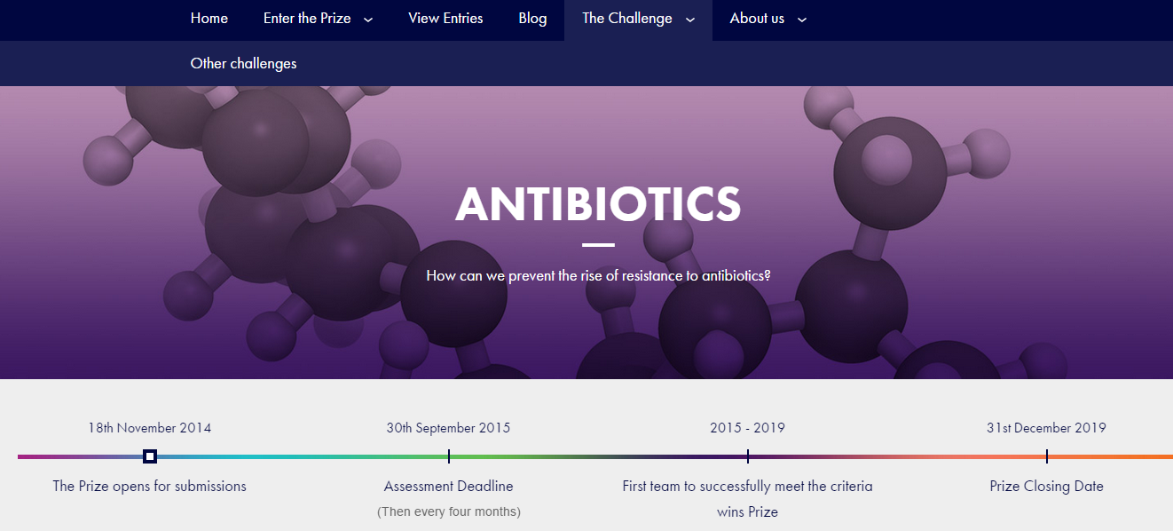

Slide 43
Evidence
Deal with uncertainty through cost-effective experimentation - and don’t go it alone! (IGL)
If making evidence, ensure it is useful, explore new data sources to monitor progress, and empower implementation agencies with the right skills, knowledge and networks
Look in surprising places for examples of how to actively absorb ideas from elsewhere – and engage in greatly needed knowledge building on effective international support for innovation collaboration (eg Newton Fund?)
Put the public back into public policies
for innovation and foster a new generation of inclusive innovation policies (process as well as outcome) to get more value from fewer inputs for more people
Experimentation
Data
Judgement
?

Slide 44
Obrigada!
Kirsten.bound@nesta.org.uk

